Slide 1
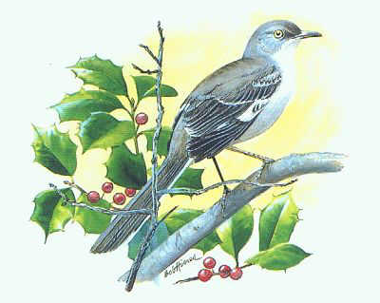
To Kill a Mockingbird
By Harper Lee

Slide 2
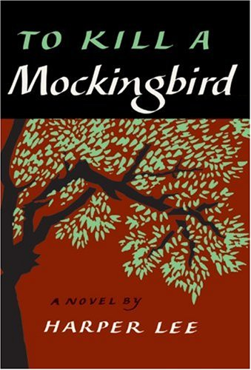
Publication of TKAM
July 11, 1960
Lee was 34 years old
Won the Pulitzer Prize for fiction in 1961
1962 movie version, starring Gregory Peck, won three Oscars
Nelle Harper Lee lived a quiet life—objected to being called a recluse

Slide 3
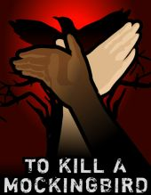
The critics say…
One of the most banned book in US
Derogatory language referring to black people, people with mental disabilities, poor people; profanity
Topics of racism, rape, poverty
“White savior” theme
Library Journal survey: Best book of the century
Lee was awarded the Presidential Medal of Freedom for contribution to literature in 2007.
Novel has sold more than 40 million copies
Sells over 1 million copies annually
Translated into more than 40 languages

Slide 4
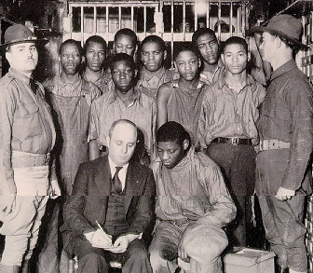
Harper Lee’s TKAM
Probably at least partly based on Lee’s own experiences growing up in Alabama
During Lee’s youth she witnessed the famous Scottsboro Trial
In the trial black men were accused of raping 2 white women and were unfairly sentenced
The result of the Scottsboro trial is largely thought to be inspiration for Lee’s novel

Slide 5
Legal Segregation in Alabama 1923-1940
No white female nurses in hospitals that treat black men
Separate passenger train cars for whites and blacks
Separate waiting rooms for whites and blacks
Separation of white and black convicts
Separate schools
No interracial marriages
Segregated water fountains
Segregated theatres

Slide 6
Narrative Arc of TKAM
Not a plot-driven story (no 5-part structure), but character-driven
Numerous inciting incidents (an episode, plot point, or event that hooks the reader and thrusts the protagonist into the main action of the story)

Slide 7
Setting
Maycomb, Alabama (fictional small town)
Early 1930s
After Great Depression and during Jim Crow era
White supremacy a major issue; echoes of slavery

Slide 8
Themes
Racial Injustice/Racism
Social Structures
Social Consciousness
Human Dignity
Human Capacity for Good & Evil
Moral, Practical, and Academic Education
Courage and Compassion
Gender Roles
Loss of Innocence

Slide 9
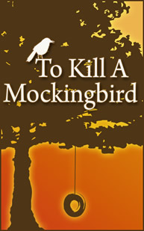
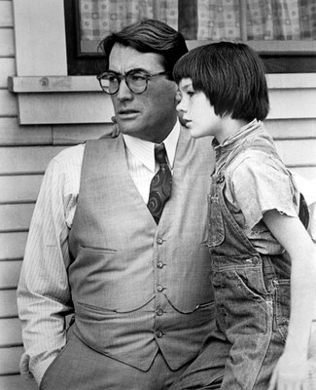
Mockingbirds don't do one thing but make music for us to enjoy…
That's why it's a sin to kill a mockingbird.

Slide 10
The Mockingbird as a Symbol
Symbolizes everything that is good and harmless in this world
Bird that sings for our pleasure.
The image or symbol appears four times in the novel.
Tom Robinson & Boo Radley connect with the mockingbird.

Slide 11
Jean Louis Finch – “Scout”
The story’s narrator
As an adult, Scout tells of the momentous events and influential people of her years during the story.
Age six when the story begins
Naturally curious

Slide 12
Regional Speech/Linguistic Practices
Speech of children
Scout, Jem, Dill, others
slang
Speech of adults to children
To explain complicated ideas, events
To discipline, educate
Speech of adults to each other

Slide 13
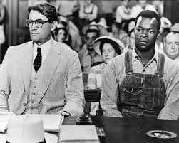
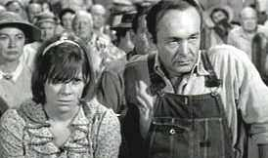
Regional Speech/Linguistic Practices
Formal language
Court room
Atticus
Colloquialisms and vernacular
Code switching (Calpurnia)
Black/white, rich/poor
Offensive language
Profanity
Racial slurs (“nigger,” “darky,” “colored,” “Negroes”)

Slide 14
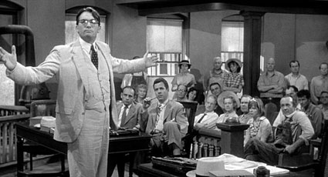
Overview
Part I: The Reclusive Boo Radley
Part II: The Trial of Tom Robinson
The novel is divided into two primary sections:
Part I: Scout and Jem are fascinated by their reclusive neighbor named Boo Radley.
Scout, Jem and a close friend, Dill, develop a strange relationship with Boo over the course of the novel
Part II: The trial of Tom Robinson, a black man accused of raping a white woman. Scout’s father, Atticus, defends Tom.

