Slide 1
Characteristics of Southern Literature
IB English 3
Lycke

Slide 2
Where is the US South? South Carolina, Georgia, Florida, Alabama, North Carolina, Virginia, Tennessee, Mississippi, Louisiana, Texas, Oklahoma, Kentucky, West Virginia , and Arkansas

Slide 3
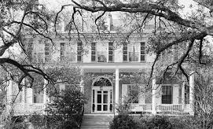
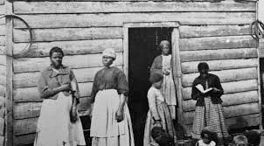
Strong sense of tradition.
“Genteel” Southern life for the rich; poverty and slavery for most others.
Some literature glorifies the traditions of chivalry and Southern honor.
Elevation of women’s innocence and delicacy. Obligation of protection by men.
An old, big house, a farm or plantation that has been lived in/on by several generations of an important family.

Slide 4
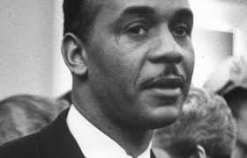
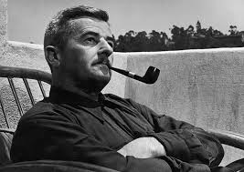
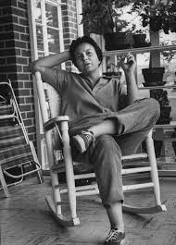
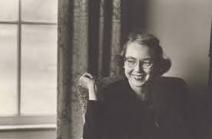
Strong sense of the past.
Centered around pre- and post-Civil War.
Slavery and the racial divisions are enforced by law and custom. Southern literature responds, engages, and argues this topic.
Some characters hold strongly to ideas of the past. Some work to resist them.

Slide 5
Importance of family and community.
The family is a huge presence in Southern literature.
Often family members have to come to terms with each other as part of the plot.
Sometimes these connections/conflicts are important long after the siblings grow up and go their separate ways.
It is hard for most Southerners, even now, to understand how a brother could move away and never be heard of again.

Slide 6
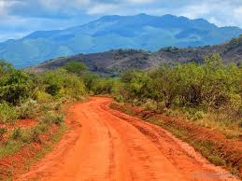
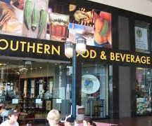
Importance of place (setting) in a physical sense.
Southern stories might not happen in another setting.
“Sense of Place” is a term that Eudora Welty often used to describe this phenomenon. It anchored the characters and the action.
For example, in “The Petrified Man,” the story HAS to be in a beauty shop, in a small town, in a time when people were fascinated with and unashamed to attend a “freak show.”

Slide 7
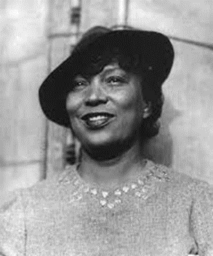
Importance of place in a linguistic sense
Vernacular and colloquialisms (local speech patterns) emphasize this. (ain’t, y’all)
Excerpts from Their Eyes Were Watching God, by Zora Neale Hurston
"At dat she ain't so ole as some of y'all dat's talking."
"She ain't even worth talkin' after," Lulu Moss drawled through her nose. "She sits high, but she looks low. Dat's what Ah say 'bout dese ole women runnin' after young boys."

Slide 8
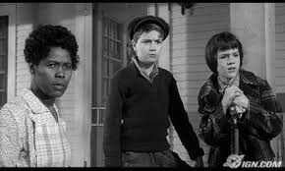
Emphasis on concrete imagery.
Southern literature is usually colorful and descriptive.
The best writers use very strong imagery as one of the important tools of creating a powerful story.
Pace is slowed down; descriptive, symbolic language draws out the details of the setting, characters, and themes.
Characters are often realistic and thoroughly developed.

Slide 9
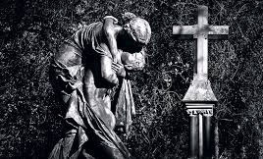
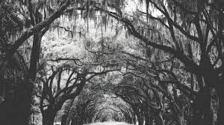
Use of Southern gothic elements
Southern gothic: decayed surroundings, bizarre behavior, insanity.
William Faulkner’s stories are full of these gothic elements as an aspect of the setting as well as presenting a theme of the past overshadowing the present.
Southern Gothic is a subgenre and includes these
isolation and marginalization (outsiders).
violence, crime, and imprisonment.
sense of place (innocence surrounded by corruption).
freakishness and the grotesque.
destitution and decay.
oppression and discrimination.

Slide 10
Use of grotesque humor
Grotesque humor: humor that derives from cruelty or injury; something comic and based on a character or event that is painful to see and funny at the same time, bizarre, abnormal, unnatural--it makes you laugh or smile, but you feel uneasy about it.
Eudora Welty’s stories and Flannery O’Connor’s stories abound with this humor.
We should not be laughing about the Bible salesman stealing Hulga’s wooden leg, but it is hard not to.

Slide 11
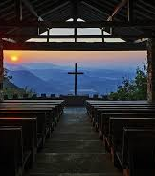
Use of religious imagery and a backdrop of Christian church
Concerns with sins, redemption, and salvation often occur.
Nearly every story Flannery O’Connor wrote contains religious imagery and elements of the Christian church.

