Slide 1
Magical Realism

Slide 2
Serious fiction helps us to name our world and see our place in it. It conveys or explores truth.
Bruce Holland Rogers

Slide 3
What is Magical Realism?
A genre of literature that depicts the real world as having an undercurrent of magic or fantasy. Magical realism is a part of the realism genre of fiction.
the world is still grounded in the real world, but fantastical elements are considered normal.
novels and short stories blur the line between fantasy and reality.

Slide 4
What Magical Realism is NOT
Escapist fiction
Fantasy world building
Speculative fiction
Science fiction
Fairy tales
Paranormal
Horror
“Magical realism differs from pure fantasy primarily because it is set in a normal, modern world with authentic descriptions of humans and society.”
–Lindsay Moore

Slide 5
Characteristics of Magical Realism
Every magical realism novel is different, but there are certain things they all include, such as:
Realistic setting. All magical realism novels take place in a setting in this world that’s familiar, and often contemporary, to the reader.
Magical elements. From talking objects to dead characters to telepathy, every magical realism story has fantastical elements that do not occur in our world. However, they are presented as normal within the novel.

Slide 6
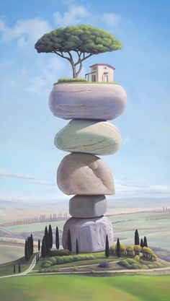
Characteristics of Magical Realism
Limited information. Magical realism authors deliberately leave the magic in their stories unexplained in order to normalize it as much as possible and reinforce that it is part of everyday life.
Critique. Authors often use magical realism to offer an implicit critique of society, most notably politics and the elite.
The genre grew in popularity in parts of the world like Latin America that were economically oppressed and exploited by Western countries. Magical realist writers used the genre to express their distaste and critique American Imperialism.

Slide 7
Characteristics of Magical Realism
Unique plot structure. Magical realism does not follow a typical narrative arc with a clear beginning, middle, and end like other literary genres. This makes for a more intense reading experience, as the reader does not know when the plot will advance or when the conflict will take place. Time may seem cyclical or disrupted.
The mixing of opposites. Inside & out, rural & urban, Western & local.
Multiple perspectives. And therefore, a lack of clarity about accuracy of events and the credibility of views expressed by the characters.
Carnivals and celebrations. These affirm the beauty and vibrancy of life and allow for absurd and humorous events.

Slide 8
Subjective Causality
Objectivity is rational, empirical, scientific, linear.
One person's emotion can't kill someone else.
Subjectivity is personal, interpretive, emotional
Magical realist works put causally connected events side by side in a way that doesn't violate objective reality but convinces us that the events described are linked by more than chance.

Slide 9
Subjective Causality
A spurned woman is dancing very angrily.
Miles away, the man who betrayed her is checking the commotion his cattle are making in the night.
Descriptions of the woman's heels stamping the floor are alternated with descriptions of the cattle trampling the man to death, back and forth from one to the other.
No assertion of causality is made, but the dancer's heels and the animals' hooves become powerfully linked.
What is conveyed is not a symbol or a metaphor, but the reality that a woman can be so angry that when she dances, her lover dies.

Slide 10
A Few Magical Realism Novels
One Hundred Years of Solitude, by Gabriel García Márquez (1967). A multi-generational story about a patriarch who dreams about a city of mirrors called Macondo then creates it according to his own perceptions.
The Satanic Verses, by Salman Rushdie (1988). The two protagonists, Gibreel Farishta and Saladin Chamcha, are both actors of Indian Muslim background. Farishta is a Bollywood superstar who specializes in playing Hindu deities. Chamcha is an emigrant who has broken with his Indian identity and works as a voiceover artist in England.
The House of the Spirits, by Isabel Allende (1982). A multi-generational story about a woman with paranormal powers and a connection to the spirit world.

Slide 11
A Few Magical Realism Novels
Beloved, by Toni Morrison (1987). A novel about a former slave haunted by an abusive ghost.
Like Water for Chocolate, by Laura Esquivel (1989). A novel about a woman whose emotions are infused in her cooking, causing unintentional effects to the people she feeds.
The Crane Wife, by Patrick Ness (2014). A retelling of a Japanese folktale. George Duncan has accepted his midlife loneliness until a wounded crane shows up in his yard with a cry like “a mournful shatter of frozen midnight.” Soon after a mysterious woman named Kumiko arrives at his print shop in London.
The Ocean at the End of the Lane, by Neil Gaiman (2013). A novel about a man who reflects on his past after returning to his hometown for a funeral.

Slide 12
“I began to wonder whether anything truly existed, whether reality wasn’t an unformed and gelatinous substance only half-captured by the senses. There was no proof that everyone perceived it in the same way; maybe Zulema, Riad Halabi, and the others had a different impression of things; maybe they did not see the same colors or hear the same sounds as I did. If that were true, each of us was living in absolute isolation. . . . At times I felt that the universe fabricated from the power of the imagination had strong and more lasting contours than the blurred realm of the flesh-and-blood creatures living around me.”
–Isabel Allende, Eva Luna

Slide 13
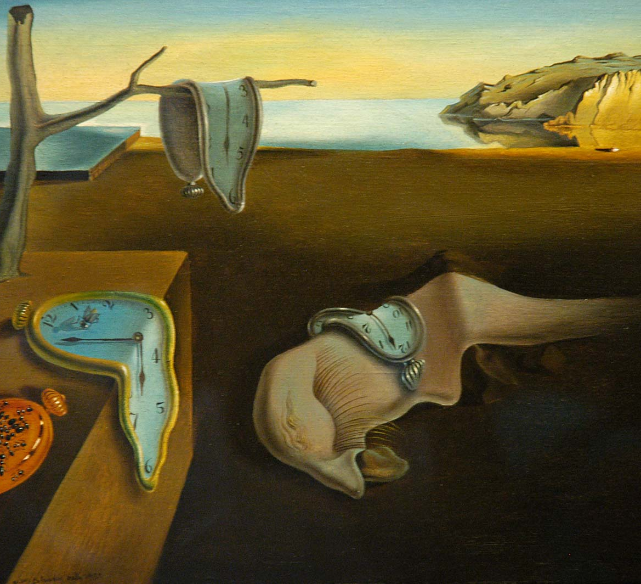
Surrealism in Art and Life
In art:
fantastic or incongruous imagery or effects in art, literature, film, or theater by means of unnatural or irrational juxtapositions and combinations.

Slide 14
In life:
“Surrealism runs through the streets. Surrealism comes from the reality of Latin America.”
"One day in Barcelona, my wife and I were asleep and the doorbell rings. I open the door and a man says to me, 'I came to fix the ironing cord.' My wife, from the bed, says, 'We don't have anything wrong with the iron here.' The man asks, 'Is this apartment two?' 'No,' I say, 'upstairs.' Later, my wife went to the iron and plugged it in and it burned up. This was a reversal. The man came before we knew it had to be fixed. This type of thing happens all the time.”
-Gabriel Garcia Marquez

