Slide 1
Language of Composition, Chapter 3: Analyzing arguments
AP Language and Composition

Slide 2
What is argument?
Persuasive discourse.
A coherent and considered movement from a claim to a conclusion.
Requires a claim, evidence, and organization.

Slide 3
What is a claim?
An assertion, proposition, or position.
Must be stated as a complete sentence.
Must be arguable (people can agree or disagree with it).
Must be an informed opinion.

Slide 4
Developing a Claim
Explore topic
Read and research
Discuss with others
Brainstorm
Take Notes
Rethink

Slide 5
Possible Topic: Single-Sex Classrooms
Consider these as claims:
Many schools have single-sex classrooms.
Single-sex classrooms have been around for years, especially in private schools.
Single-sex classrooms are ineffective because they do not prepare students for the realities of the workplace.

Slide 6
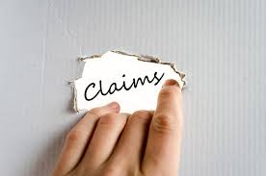
Types of Claims
Claims of fact
Claims of value
Claims of policy

Slide 7
Claim of Fact
Asserts that something is true or not true.
Pivots on what exactly is “factual.”
Facts are arguable when they are questioned, raise controversy, or challenge beliefs.
New “facts” call into question older “facts.”

Slide 8
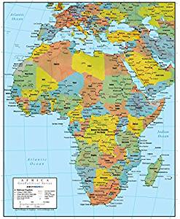
Evaluating Claims of Fact
Zimbabwe is in Africa.
Zimbabwe has an unstable government.
Restaurants on Main Street serve more customers at breakfast than lunch.
Restaurants on Main Street are more popular with older clients than younger ones.
It is a fact that the Social Security program will be bankrupt by 2025.

Slide 9
Claim of Value
Argues that something is good or bad, right or wrong, desirable or undesirable.
Requires establishing criteria or standards for judgment.

Slide 10
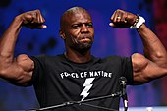
Evaluating Claims of Value
Terry Crews is the best-prepared actor on Brooklyn Nine-Nine.
What criteria could we use for determining “best-prepared”?

Slide 11
Claim of Policy
Argues for a proposed change
Argument begins with a definition of the problem (claim of fact), then
explains why the issue is a problem (claim of value), then
explains the change that needs to happen (claim of policy).

Slide 13
What claims does the image make?
Claim of fact?
This “assault weapon” is made up of camera parts, an imaginative construction
Claim of value?
Establishes a connection between access to information and firepower.
Verbal metaphor: “ Information is Ammunition”
Claim: Information is power
Claim of policy?
“Defend press freedom” by visiting Canadian Journalists for Free Expression’s website.
Claim: Take action; support CJFE

Slide 14
From Claim to Thesis
To develop a claim into a thesis statement, be specific about what you intend to argue.
Professional essays often imply the claim.
Formal academic essays explicitly state the claim in a one-sentence thesis statement in the introduction of the argument.

Slide 15
Closed Thesis Statement
A statement of the argument that also previews the author’s major points.
Limits the number of points the writer will make.
Useful to focus a shorter, timed essay.

Slide 16
Closed Thesis Statement
The books in the Harry Potter series have become legendary children’s books and enduring classics because of their three-dimensional characters, exciting plots, and complex themes.

Slide 17
Open Thesis Statement
Does not list all the author’s points.
A longer essay might make six or seven points. Stringing them all out in a thesis would be awkward.
Makes the overall point without actually stating every subpoint, guiding the essay without being cumbersome.

Slide 18
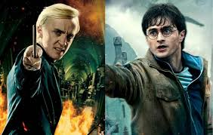
Open Thesis Statement
The popularity of the Harry Potter series demonstrates that simplicity trumps complexity when it comes to the taste of readers, both young and old.

Slide 19
Counterargument Thesis Statement
A summary of the counterargument precedes the writer’s opinion.
Usually preceded by although or but.
Immediately addresses the counterargument.

Slide 20
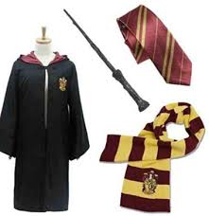
Counterargument Thesis Statement
Although the Harry Potter series may have some literary merit, its popularity has less to do with storytelling than with merchandising.

Slide 21
TAG
Use a TAG to ground your reader in the text:
T – title
A – author
G – genre
In the memoir Into Thin Air, by Jon Krakauer…

Slide 22
Presenting Evidence
Relevant
Explain the relationship between evidence and commentary (MELCon)
Accurate
Quote and cite sources correctly
Don’t misrepresent source or take info out of context
Consider bias
Use credible sources (CRAP test)
Sufficient
Enough to support your thesis
Different perspectives may be warranted

Slide 23
CRAP Test: Useful for all kinds of texts
Currency
Reliability
Authority
Purpose/Point of View

Slide 24
CRAP Test: Useful for all kinds of texts
Currency
How recent is the information?
How recently has the website been updated?
Is it current enough for your topic?

Slide 25
CRAP Test: Useful for all kinds of texts
Reliability
What kind of information is included in the resource?
Is content of the resource primarily opinion? Is it balanced?
Does the creator provide references or sources for data or quotations?

Slide 26
CRAP Test: Useful for all kinds of texts
Authority
Who is the creator or author?
What are the credentials? Can you find any information about the author's background?
Who is the publisher or sponsor?
Are they reputable?
What is the publisher's interest (if any) in this information?
Are there advertisements on the website? If so, are they clearly marked?

Slide 27
CRAP Test: Useful for all kinds of texts
Purpose/Point of View
Is this fact or opinion? Does the author list sources or cite references?
What is the bias or perspective? Does the author seem to be trying to push an agenda or particular side?
Is the creator/author trying to sell you something? If so, is it clearly stated?

Slide 28
Logical Fallacies

Slide 29
Logical Fallacies
Vulnerabilities or weaknesses in arguments
Failure to make a logical link between claim and evidence
Can be accidental
Can be used intentionally to deceive
Analyze weak points in other’s arguments
Check for fallacies in your own writing to strengthen your argument

Slide 30
Fallacies of Relevance
Red herring
Ad hominem
Faulty analogy
Appeal to false authority

Slide 31
Fallacies of Accuracy
Straw Man
False dilemma (either/or)
Equivocation
Post hoc ergo propter hoc
Begging the question

Slide 32
Fallacies of Insufficiency
Hasty generalization
Circular reasoning
Bandwagon appeal (ad populum)

Slide 33
Types of Evidence

Slide 34
First-Hand Evidence
Something you—the author—know
For Example: Social Media

Slide 35
Types of First-Hand Evidence
Personal evidence—writer speaks as an insider
Anecdotes—stories about others that you have observed or been told
Current events—your general knowledge; understand multiple perspectives from observing

Slide 36
Second-Hand Evidence
Research, reading, and investigation
Primarily appeals to logos (pathos and ethos may also be established)

Slide 37
Types of Second-Hand Evidence
Historical Information
Provides background and context
Verifiable facts
Be careful of bias
Often used to develop a point of contrast to today
Expert Opinion
Who counts as an expert?
Data
Quantitative information—numerical statistics (percent, trends, survey results, census information, etc.)
Qualitative information—verbal conclusions from research (interviews, observations, participation)

