Slide 1
human Growth and Development
Dr. Lycke

Slide 2
Developmental Psychology
Definition --The study of how people grow and change throughout the lifespan—from birth to death.
Infancy/childhood
Adolescence
Adulthood/Geriatrics
Research Methods
Longitudinal – long-term research study of participants over stages, years, or even decades
Cross-sectional – participants are of different ages/stages and compared
WHY STUDY HUMAN DEVELOPMENT?
WHAT ARE THE ADVANTAGES AND DISADVANTAGES OF THESE RESEARCH METHODS?

Slide 3
7-up longitudinal study 1964-2012

Slide 4
Life Stages
Infancy: birth to 1 year
Early childhood: 1-6 years
Late childhood: 6-12 years
Adolescence: 12-20 years
Early adulthood: 20-40 years
Middle adulthood: 40-65 years
Late adulthood: 65 years and up

Slide 5
Three main types of Growth and Development
Physical: body growth
Social/Emotional: interactions and relationships with others
Cognitive: mental development and brain development
Do all three types of development occur during each stage of development?
How might types of development overlap?

Slide 6
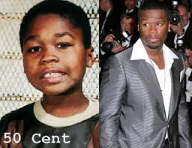
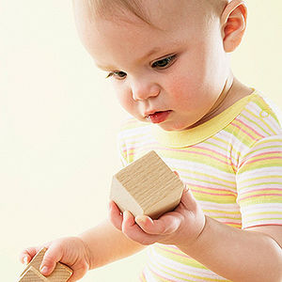
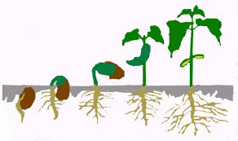
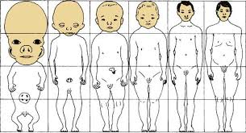
Questions of developmental psychology
How do heredity and environment determine influence and contribute to human development?
Does development happen in stages or does it occur continuously over time?
What are the boundaries of “normal” development?
What are we biologically “programmed” to know, be able to do, and care about? (maturation= an unfolding of behavior)
What are the critical periods for certain kinds of development?

Slide 7
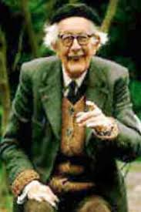
Jean Piaget: 1896-1980 stages of cognitive development
Identified 4 stages of cognitive development that everyone goes through in the same order.
Children reach the stages at different times in their lives.

Slide 8
Piaget
Swiss psychologist, trained as a biologist, published research about mollusks in his teens.
Believed that learning is an adaptive feature of human capacity.
Researched his own 3 children from birth.
As a biologist he believed that physical structures carry out important functions; learning (adapting, problem solving) is a function that happens in the brain.

Slide 9
2 Inherent Mental Functions
Organization—we organize info into psychological structures Piaget calls schema (schemata, pl.); schemata help us form mental representations and categorization systems.
Adaptation—we adapt to our physical and social worlds (stress on physical) through 2 processes
Assimilation— fitting new info into existing schemata (skunk = kitty)
Accommodation— altering existing schemata or creating new ones in response to new info
→ A key idea for understanding the stages of development: Operations—conceptualizations that have been “interiorized.”

Slide 11
Piaget’s stages of development

Slide 12
4 factors that interact and influence the changes in thinking
Maturation—biological changes that are genetically programmed
Activity—interacting with the physical world and experimenting with ideas
Social experiences—watching
Equilibration—mental balance between what we know and experience in the world.
disequilibration something is a bit off; searching for a solution

Slide 13
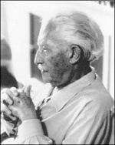
Erik Erikson: 1902-1994 Stages of Psychosocial Development
Psychoanalyst who identified 8 stages of psychosocial development.
For each stage, a basic conflict or task has to be met.
Healthy development depends on getting through each “crisis.”

Slide 14
Erikson
Born in Frankfurt, Germany.
Through his travels around Europe and his immigration to the US (1933), he observed that the developing relationship between culture and the individual follow similar patterns in every society.
Believed that because all humans have the same basic need, society should provide for those needs.
Interested in emotional changes and their relationship to the social environment.

Slide 15
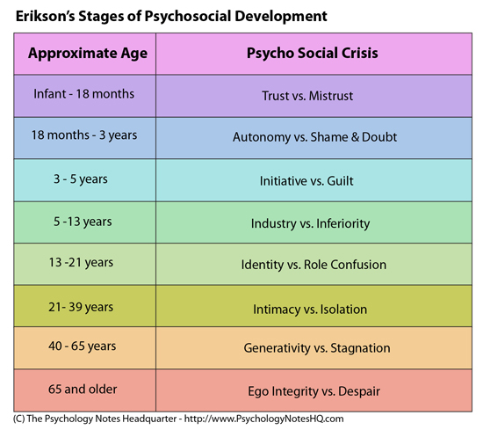

Slide 16
Disney Pixar and Erkison’s PsychosocialDevelopment

