Slide 1
Psychology
Fifth Edition
Saundra K. Ciccarelli
J. Noland White
Saundra K. Ciccarelli
J. Noland White
Copyright © 2018, 2015, 2012 Pearson Education, Inc. All Rights Reserved

Slide 2
Psychology
Fifth Edition
Chapter 12
12
Social Psychology

Slide 3
Learning Objectives 1 of 2
12.1 Identify factors that influence people or groups to conform to the actions of others.
12.2 Explain how our behavior is impacted by the presence of others.
12.3 Compare and contrast three compliance techniques.
12.4 Identify factors that make obedience more likely.
12.5 Identify the three components of an attitude and how attitudes are formed.
12.6 Describe how attitudes can be changed.
12.7 Explain how people react when attitudes differ from behavior.
12.8 Describe how people form impressions of others.

Slide 4
Learning Objectives 2 of 2
12.9 Describe the process of explaining one’s own behavior and the behavior of others.
12.10 Distinguish between prejudice and discrimination.
12.11 Describe theories of how prejudice is learned and how it can be overcome.
12.12 Identify factors involved in interpersonal attraction.
12.13 Describe the different types of love outlined in Sternberg’s theory.
12.14 Explain how aggressive behavior is determined by biology and learning.
12.15 Identify the factors influencing why people help others.
12.16 Define social neuroscience.

Slide 5
Conformity 1 of 2
Learning Objective 12.1 Identify factors that influence people or groups to conform to the actions of others.
Social psychology: the scientific study of how a person’s behavior, thoughts, and feelings influence and are influenced by social groups
Includes the social world in which we exist, as we are surrounded by others to whom we are connected and by whom we are influenced in so many ways

Slide 6
Conformity 2 of 2
Social influence: the process through which the real or implied presence of others can directly or indirectly influence the thoughts, feelings, and behavior of an individual
Conformity: changing one’s own behavior to match that of other people

Slide 7
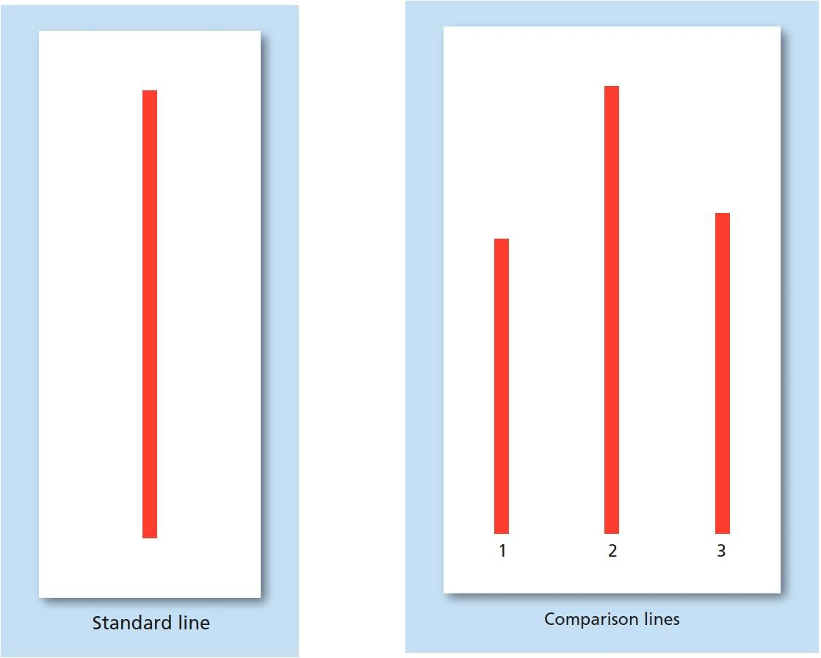
Figure 12.1 Stimuli Used in Asch’s Study
Participants in Asch’s famous study on conformity were first shown the standard line. They were then shown the three comparison lines and asked to determine to which of the three was the standard line most similar. Which line would you pick? What if you were one of several people, and everyone who answered ahead of you chose line 3? How would that affect your answer? Source: Adapted from Asch (1956).

Slide 8
Group Behavior 1 of 4
Learning Objective 12.2 Explain how our behavior is impacted by the presence of others.
Groupthink: occurs when people place more importance on maintaining group cohesiveness than on assessing the facts of the problem with which the group is concerned

Slide 9
Table 12.1 Characteristics of Groupthink
Characteristic | Description
Invulnerability | Members feel they cannot fail.
Rationalization | Members explain away warning signs and help each other rationalize their decision.
Lack of Introspection | Members do not examine the ethical implications of their decisions because they believe that they cannot make immoral choices.
Stereotyping | Members stereotype their enemies as weak, stupid, or unreasonable.
Pressure | Members pressure each other not to question the prevailing opinion.
Lack of disagreement | Members do not express opinions that differ from the group consensus.
Self-deception | Members share in the illusion that they all agree with the decision.
Insularity | Members prevent the group from hearing disruptive but potentially useful information from people who are outside the group.
Source: Janis (1972, 1982). | Blank cell

Slide 10
Group Behavior 2 of 4
Group polarization: members involved in a group discussion tend to take somewhat more extreme positions and suggest riskier actions when compared to individuals who have not participated in a group discussion

Slide 11
Group Behavior 3 of 4
Social facilitation: positive influence of others on performance
Social impairment: negative influence of others on performance
Social loafing: people who are lazy tend not to do as well when others are also working on same task
Cultural assumptions

Slide 12
Group Behavior 4 of 4
Deindividuation: a lessening of one’s sense of personal identity and personal responsibility
Groups or crowds can offer a sense of anonymity
Stanford prison experiment

Slide 13
Compliance 1 of 2
Learning Objective 12.3 Compare and contrast three compliance techniques.
Compliance: changing one’s behavior as a result of other people directing or asking for the change
Consumer psychology: branch of psychology that studies the habits of consumers in the marketplace, including compliance

Slide 14
Compliance 2 of 2
Learning Objective 12.2 Ways to Gain Compliance
Foot-in-the-door technique: asking for a small commitment and, after gaining compliance, asking for a bigger commitment
Door-in-the-face technique: asking for a large commitment and then, after being refused, asking for a smaller commitment
Lowball technique: getting a commitment from a person and then raising the cost of that commitment

Slide 15
Obedience
Learning Objective 12.4 Identify factors that make obedience more likely.
Obedience: changing one’s behavior at the command of an authority figure
Milgram’s shocking research: “teacher” administered what he or she thought were real shocks to a “learner”
Participants consistently follow orders to administer apparently painful shocks
Raised ethical questions about how far researchers should be willing to go

Slide 16
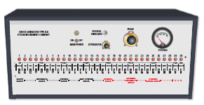
Figure 12.2 Control Panel in Milgram’s Experiment
In Stanley Milgram’s classic study on obedience, the participants were presented with a control panel like this one. Each participant (“teacher”) was instructed to give electric shocks to another person (the “learner,” who only pretended to be shocked). At what point do you think you would have refused to continue the experiment?

Slide 17
Table 12.2 Sample Script Similar to Those in Milgram’s Classic Experiment
Voltage of “Shock” | Learner’s Script
120 | “Ouch! Experimenter, let me out of here, I’m through! Please, I have heart trouble, I don’t want to go on.”
150 | “That’s it, enough! I will not be part of this experiment, let me out now!”
300 | (Scream of pain heard in the background) ”I am not doing this anymore, you can’t make me stay here. Get me out, get me out!”
330 | (Louder and longer scream of pain) ”Get me out, get me out, my heart, my heart! My chest hurts, get me out of here, let me out of here, you have no right to do this! Let me out of here!”
Blank cell | Source: Milgram (1964a, 1974).

Slide 18
Social Cognition
Social cognition - the mental processes that people use to make sense of the social world around them.
How we perceive others
First impressions
How we explain behavior of others and ourselves

Slide 19
Attitudes 1 of 3
Learning Objective 12.5 Identify the three components of an attitude and how attitudes are formed.
Attitude: a tendency to respond positively or negatively toward a certain person, object, idea, or situation
Three components of an attitude:
Affective (emotional) component
Behavioral component
Cognitive component

Slide 20
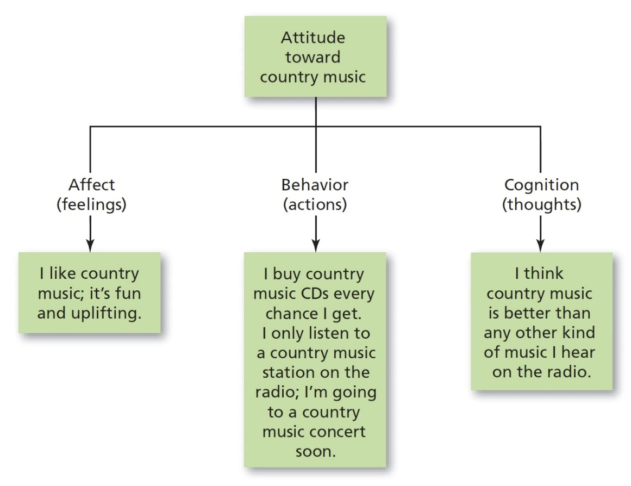
Figure 12.3 Three Components of an Attitude
Attitudes consist of the way a person feels and thinks about something, as well as the way the person chooses to behave. If you like country music, you are also likely to think that country music is good music. You are also more likely to listen to this style of music, buy this type of music, and even go to a performance. Each of the three components influences the other two.

Slide 21
Attitudes 2 of 3
Attitudes are often poor predictors of behavior unless the attitude is very specific or very strong

Slide 22
Attitudes 3 of 3
Attitude Formation
Direct contact with the person, situation, object, or idea
Direct instruction from parents or others
Interacting with other people who hold a certain attitude
Vicarious conditioning: watching the actions and reactions of others to ideas, people, objects, and situations

Slide 23
Attitude Change: The Art of Persuasion 1 of 2
Learning Objective 12.6 Describe how attitudes can be changed.
Persuasion: the process by which one person tries to change the belief, opinion, position, or course of action of another person through argument, pleading, or explanation
Key elements in persuasion are source of the message, the message itself, the target audience, and the medium

Slide 24
Attitude Change: The Art of Persuasion 2 of 2
Elaboration Likelihood Model
People will either elaborate on the persuasive message or fail to elaborate on it
Future actions of those who do elaborate are more predictable than those who do not
Central-route processing: involves attending to the content of the message itself
Peripheral-route processing: involves attending to factors not involved in the message, such as the expertise of the source of the message, the length of the message, and other non-content factors

Slide 25
Cognitive Dissonance: When Attitudes and Behavior Clash
Learning Objective 12.7 Explain how people react when attitudes differ from behavior.
Cognitive dissonance: sense of discomfort or distress that occurs when a person’s behavior does not correspond to that person’s impression
Lessened by changing the conflicting behavior, changing the conflicting attitude, or forming a new attitude to justify the behavior

Slide 26
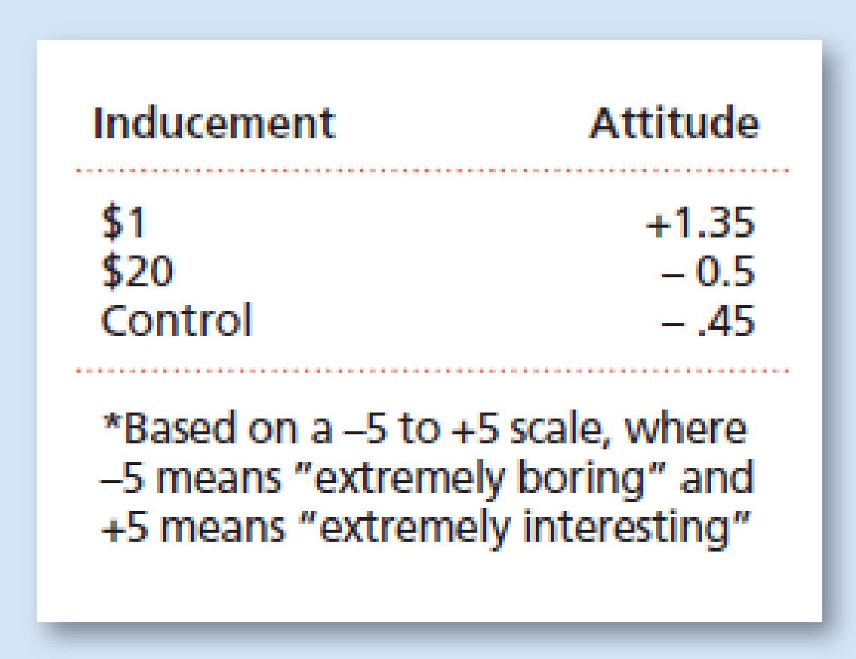
Figure 12.4 Cognitive Dissonance: Attitude Toward a Task
After completing a boring task, some participants were paid $1 and some $20 to convince others waiting to do the same task that the task was interesting and fun. Surprisingly, the participants who were paid only $1 seemed to change their own attitude toward the task, rating it as interesting, whereas those who were paid $20 rated the task no differently than a control group did. SOURCE: Adapted from Festinger and Carlsmith (1959).

Slide 27
Impression Formation 1 of 3
Learning Objective 12.8 Describe how people form impressions of others.
Impression formation: forming of the first knowledge a person has about another person
Primacy effect: the very first impression one has about a person tends to persist even in the face of evidence to the contrary

Slide 28
Impression Formation 2 of 3
Social categorization: the assignment of a person one has just met to a category based on characteristics the new person has in common with other people with whom one has had experience in the past
Stereotype: a set of characteristics that people believe is shared by all members of a particular social category

Slide 29
Impression Formation 3 of 3
Implicit personality theory: sets of assumptions about how different types of people, personality traits, and actions are related to each other
Implicit Association Test (IAT): measures the degree of association between concepts
Schemas: mental patterns that represent what a person believes about certain types of people
Schemas can become stereotypes

Slide 30
Attribution 1 of 3
Learning Objective 12.9 Describe the process of explaining one’s own behavior and the behavior of others.
Attribution: the process of explaining one’s own behavior and the behavior of others
Attribution theory: the theory of how people make attributions

Slide 31
Attribution 2 of 3
Situational cause: cause of behavior attributed to external factors
Delays
Action of others
Some other aspect of the situation
Dispositional cause: cause of behavior attributed to internal factors
Personality
Character

Slide 32
Attribution 3 of 3
Fundamental attribution error (actor-observer bias): the tendency to overestimate the influence of internal factors in determining behavior while underestimating situational factors
Cross-cultural differences in attribution
Age as factor in attribution
Motive as factor in attribution

Slide 33
Prejudice and Discrimination 1 of 3
Learning Objective 12.10 Distinguish between prejudice and discrimination.
Prejudice: negative attitude held by a person about the members of a particular social group
Discrimination: treating people differently because of prejudice toward the social group to which they belong

Slide 34
Prejudice and Discrimination 2 of 3
Forms of prejudice include ageism, sexism, racism, and prejudice against those who are too fat or too thin
In-groups: social groups with whom a person identifies; “us”
Out-groups: social groups with whom a person does not identify; “them”

Slide 35
Prejudice and Discrimination 3 of 3
Scapegoating: tendency to direct prejudice and discrimination at out-group members who have little social power or influence

Slide 36
How People Learn and Overcome Prejudice 1 of 5
Learning Objective 12.11 Describe theories of how prejudice is learned and how it can be overcome.
Social cognitive theory: views prejudice as an attitude acquired through direct instruction, modeling, and other social influences
Realistic conflict theory: conflict between groups increases prejudice and discrimination

Slide 37
How People Learn and Overcome Prejudice 2 of 5
Social identity theory: the formation of a person’s identity within a particular social group is explained by social categorization, social identity, and social comparison
Social identity: the part of self-concept including one’s view of self as a member of a particular social category
Social comparison: the comparison of oneself to others in ways that raise one’s self-esteem

Slide 38
How People Learn and Overcome Prejudice 3 of 5
Stereotype vulnerability: the effect that people’s awareness of the stereotypes associated with their social group has on their behavior
Self-fulfilling prophecy: the tendency of one’s expectations to affect one’s behavior in such a way as to make the expectation more likely to occur

Slide 39
How People Learn and Overcome Prejudice 4 of 5
Education and intergroup contact
Equal status contact: contact between groups in which the groups have equal status, with neither group having power over the other
Robber’s Cave study

Slide 40
How People Learn and Overcome Prejudice 5 of 5
“Jigsaw classroom”: educational technique in which each individual is given only part of the information needed to solve a problem, forcing individuals to work together to find the solution

Slide 41
Interpersonal Attraction
Learning Objective 12.12 Identify factors involved in interpersonal attraction.
Interpersonal attraction: liking or having the desire for a relationship with another person
Physical attractiveness
Proximity: physical or geographical nearness
Birds of a feather: people like people who are similar to themselves
Complementarity is another aspect of this
Reciprocity of liking: tendency of people to like other people who like them in return

Slide 42
Love Is a Triangle: Robert Sternberg’s Triangular Theory of Love 1 of 2
Learning Objective 12.13 Describe the different types of love outlined in Sternberg’s theory.
Love: a strong affection for another person due to kinship, personal ties, sexual attraction, admiration, or common interests
Sternberg’s three components of love:
Intimacy
Passion
Commitment

Slide 43
Love Is a Triangle: Robert Sternberg’s Triangular Theory of Love 2 of 2
Romantic love: consists of intimacy and passion
Companionate love: consists of intimacy and commitment
Consummate love: ideal love, in which all three components are present

Slide 44
Aggression 1 of 3
Learning Objective 12.14 Explain how aggressive behavior is determined by biology and learning.
Aggression: behavior intended to hurt or destroy another person
Frustration–aggression hypothesis: aggression is a reaction to frustration
Konrad Lorenz saw aggression as an instinct for fighting to promote the survival of our species

Slide 45
Aggression 2 of 3
Biological influences on aggression may include genetics, the amygdala and limbic system, and testosterone and serotonin levels
Alcohol has impact on aggression

Slide 46
Aggression 3 of 3
Social role: the pattern of behavior that is expected of a person who is in a particular social position
Violent TV, movies, and video games also related to aggression

Slide 47
Prosocial Behavior 1 of 4
Learning Objective 12.15 Identify the factors influencing why people help others.
Prosocial behavior: socially desirable behavior that benefits others
Altruism: prosocial behavior that is done with no expectation of reward and may involve the risk of harm to oneself
Temporoparietal junction (TPJ) is larger in individuals who make altruistic choices

Slide 48
Prosocial Behavior 2 of 4
Bystander effect: the effect that the presence of other people has on the decision to help or not help
Help becomes less likely as the number of bystanders increases
Case of Kitty Genovese

Slide 49
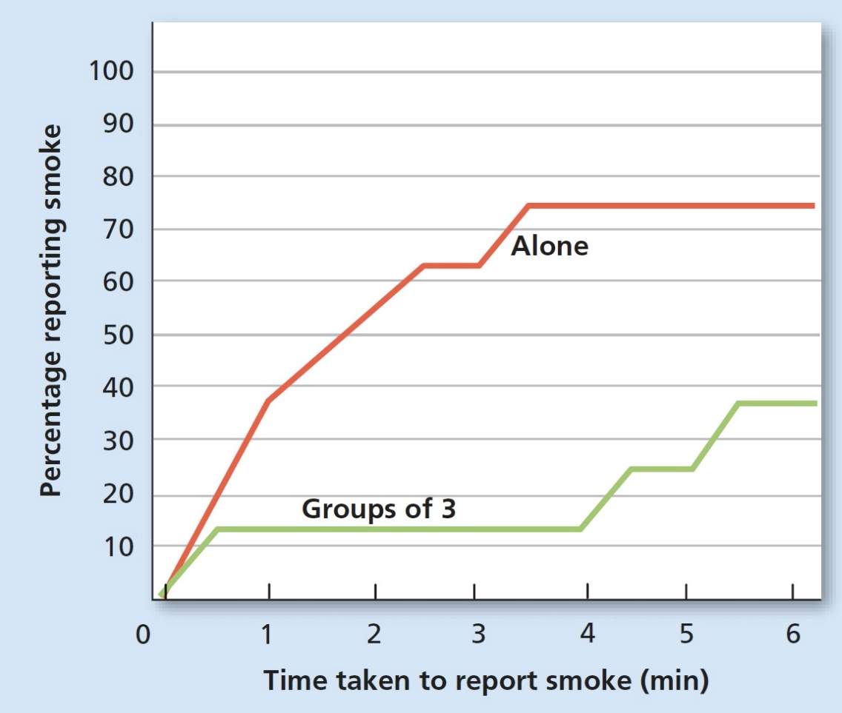
Figure 12.5 Elements Involved in Bystander Response
In a classic experiment, participants were filling out surveys as the room began to fill with smoke. As you can see in the accompanying graph, the time taken to report smoke and the percentage of people reporting smoke both depended on how many people were in the room at the time the smoke was observed. If a person was alone, he or she was far more likely to report the smoke and report it more quickly than when there were three people. Source: Latané & Darle (1969).

Slide 50
Prosocial Behavior 3 of 4
Diffusion of responsibility: a person fails to take responsibility for action or for inaction because of the presence of other people who are seen to share the responsibility
Researchers Latané and Darley found that people who were alone were more likely to help in an emergency than people who were with others
One bystander cannot diffuse responsibility

Slide 51
Prosocial Behavior 4 of 4
Five steps in making a decision to help
Noticing
Defining an emergency
Taking responsibility
Planning a course of action
Taking action

Slide 52
Table 12.3 Help or Don’t Help: Five Decision Points
Decision Point | Description | Factors Influencing Decision
Noticing | Realizing that there is a situation that might be an emergency | Hearing a loud crash or a cry for help.
Defining an Emergency | Interpreting the cues as signaling an emergency | Loud crash if associated with a car accident, people are obviously hurt.
Taking Responsibility | Personally assuming the responsibility to act | A single bystander is much more likely to act than when others are present (Latané & Darley. 1969.)
Planning a Course of Action | Deciding how to help and what skills might be needed | People who feel they have the necessary skills to help are more likely to help.
Taking Action | Actually helping | Cost of helping (e.g. danger to self) must not outweigh the rewards of helping.

Slide 53
Peaking Inside the Social Brain
Learning Objective 12.16 Define social neuroscience.
Social neuroscience: the study of how biological processes influence social behavior
Studies use fMRI and other imaging techniques to discover areas of the brain involved in social actions
TJP involved in prosocial behavior and competitive behavior

