Slide 1
Psychology
Fifth Edition
Saundra K. Ciccarelli
J. Noland White
Saundra K. Ciccarelli
J. Noland White
Copyright © 2018, 2015, 2012 Pearson Education, Inc. All Rights Reserved

Slide 2
Psychology
Fifth Edition
Chapter 7
7
Cognition: Thinking, Intelligence, and Language

Slide 3
Learning Objectives 1 of 2
7.1 Explain how mental images are involved in the process of thinking.
7.2 Describe how concepts and prototypes influence our thinking.
7.3 Identify some methods that people use to solve problems and make decisions.
7.4 Identify three common barriers to successful problem solving.
7.5 Recall some characteristics of creative, divergent thinking.
7.6 Compare and contrast different theories on the nature of intelligence.
7.7 Compare and contrast some methods of measuring intelligence.
7.8 Identify ways to evaluate the quality of a test.

Slide 4
Learning Objectives 2 of 2
7.9 Define intellectual disability, giftedness, and emotional intelligence.
7.10 Evaluate the influence of heredity and environment on the development of intelligence.
7.11 Identify the different elements and structure of language.
7.12 Explain how language develops.
7.13 Evaluate whether or not language influences how people think.
7.14 Summarize the research on the ability of animals to communicate and use language.
7.15 Identify some methods for improving your cognitive health.

Slide 5
Mental Imagery
Learning Objective 7.1 Explain how mental images are involved in the process of thinking.
Thinking (cognition): mental activity that goes on in brain when a person is processing information
Processing includes organizing, understanding, and communicating information to others
Mental images: mental representations that stand for objects or events and have a picture-like quality

Slide 6
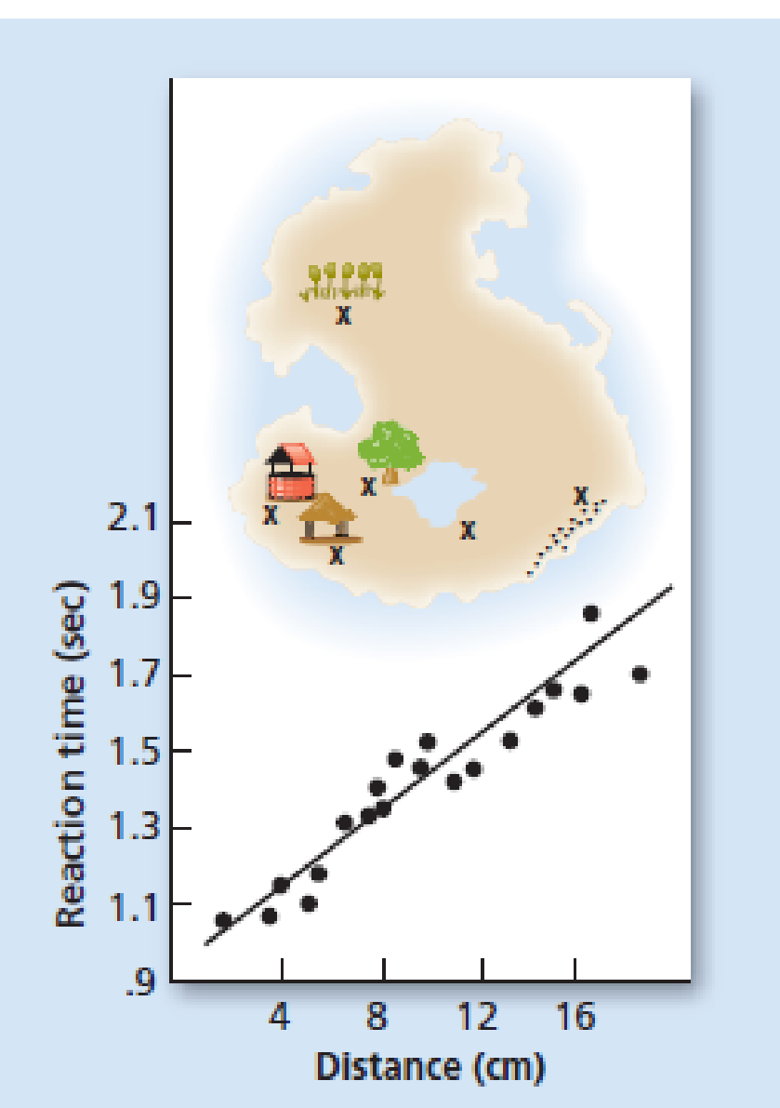
Figure 7.1 Kosslyn’s Fictional Island
In Kosslyn’s 1978 study, participants were asked to push a button when they had imagined themselves moving from one place on the island to another. As the graph below the picture shows, participants took longer times to complete the task when the locations
on the image were farther apart.
Source: Kosslyn et al. (1978).

Slide 7
Concepts and Prototypes 1 of 2
Learning Objective 7.2 Describe how concepts and prototypes influence our thinking.
Concepts: ideas that represent a class or category of objects, events, or activities
Formal concepts: concepts that are defined by specific rules or features
Natural concepts: concepts people form as a result of their experiences in the real world
Platypus is a “fuzzy” natural concept

Slide 8
Concepts and Prototypes 2 of 2
Prototype: a concept that closely matches the defining characteristics of that concept
Prototypes develop according to exposure a person has to objects in that category

Slide 9
Problem Solving and Decision-Making Strategies 1 of 4
Learning Objective 7.3 Identify some methods that people use to solve problems and make decisions.
Problem solving: occurs when a goal must be reached by thinking and behaving in certain ways
Decision making: identifying, evaluating, and choosing between alternatives

Slide 10
Problem Solving and Decision-Making Strategies 2 of 4
Trial and error (mechanical solution): problem-solving method in which one possible solution after another is tried until a successful one is found
Algorithms: very specific, step-by-step procedures for solving certain types of problems
Will always result in a correct solution if one exists to be found, such as mathematical formulas

Slide 11
Problem Solving and Decision-Making Strategies 3 of 4
Heuristic: educated guess based on prior experiences that helps narrow down possible solutions for a problem
Also known as a “rule of thumb”
Representative heuristic
Availability heuristic
Working backward
Subgoals

Slide 12
Problem Solving and Decision-Making Strategies 4 of 4
Insight: sudden perception of a solution to a problem
“Aha!” moment
Problem may be recognized as similar to another previously solved, for example

Slide 13
Problems with Problem Solving and Decision Making 1 of 2
Learning Objective 7.4 Identify three common barriers to successful problem solving.
Functional fixedness: a block to problem solving that comes from thinking about objects only in terms of their typical functions
Mental set: the tendency for people to persist in using problem-solving patterns that have worked for them in the past

Slide 14
Problems with Problem Solving and Decision Making 2 of 2
Confirmation bias: the tendency to search for evidence that fits one’s beliefs while ignoring any evidence that does not fit those beliefs

Slide 15
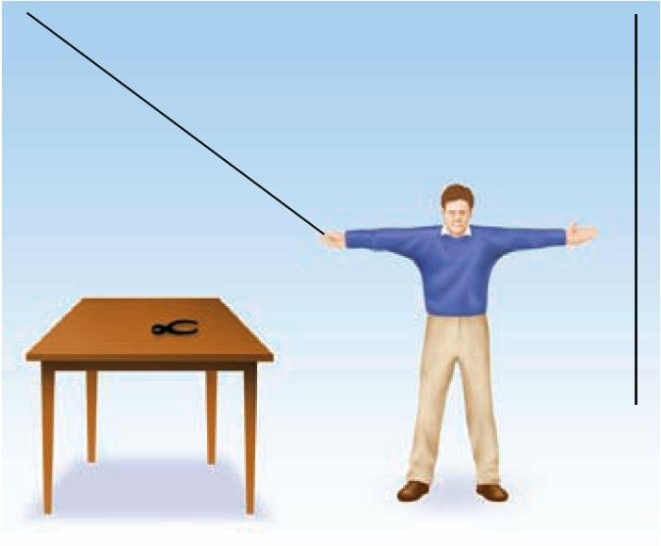
Figure 7.2 The String Problem 1 of 2
How do you tie the two strings together if you cannot reach them both at the same time?

Slide 16
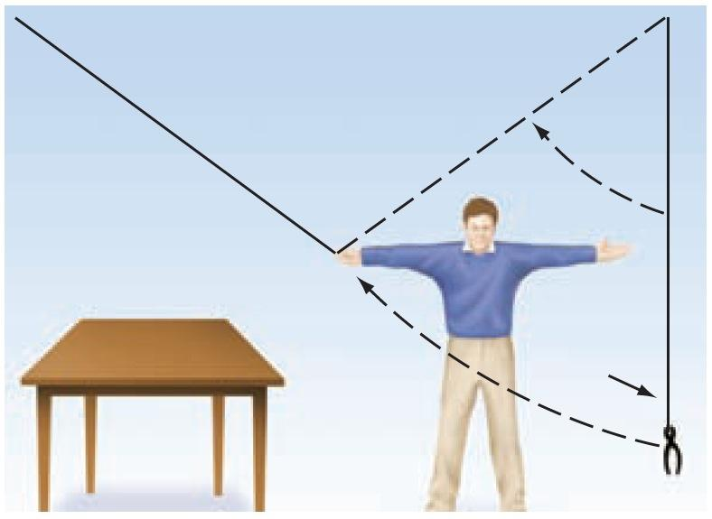
Figure 7.2 Solution to the String Problem 2 of 2
The solution to the string problem is to use the pliers as a pendulum to swing the second string closer to you.

Slide 17
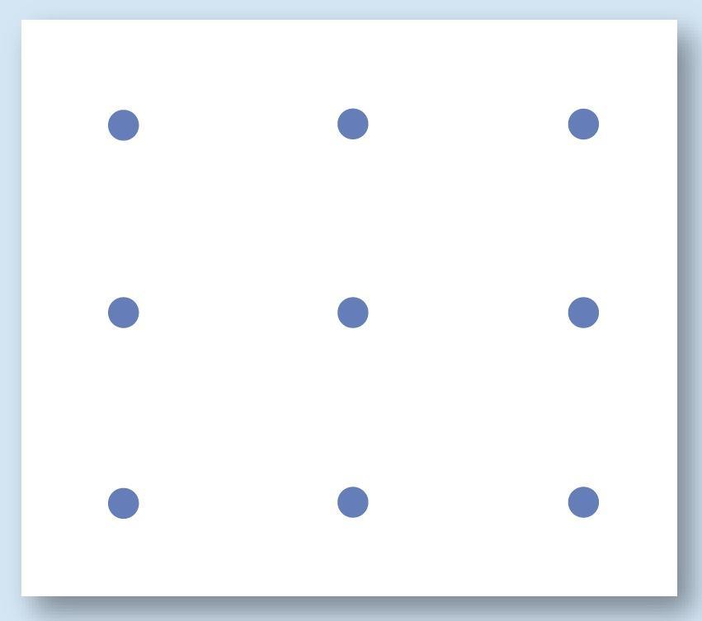
Figure 7.3 The Dot Problem 1 of 2
Can you draw four straight lines so that they pass through all nine dots without lifting your pencil from the page and without touching any dot more than once?

Slide 18
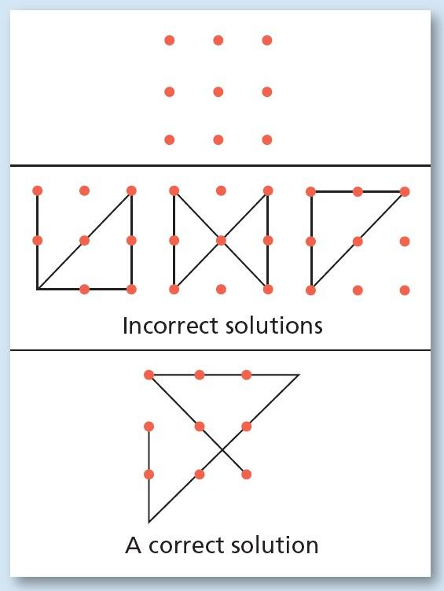
Figure 7.3 Solution to the Dot Problem 2 of 2
When people try to solve this problem, a mental set causes them to think of the dots as representing a box, and they try to draw the line while staying in the box.
The only way to connect all nine dots without lifting the pencil from the paper is to draw the lines so they extend out of the box of dots—literally “thinking outside the box.”

Slide 19
Creativity
Learning Objective 7.5 Recall some characteristics of creative, divergent thinking.
Creativity: the process of solving problems by combining ideas or behavior in new ways
Convergent thinking: a problem is seen as having only one answer, and all lines of thinking will eventually lead to (converge on) that single answer, using previous knowledge and logic
Divergent thinking: a person starts from one point and comes up with many different ideas or possibilities based on that point (a kind of creativity)

Slide 20
Table 7.1 Stimulating Divergent Thinking
Blank cell | Stimulating Divergent Thinking
Brainstorming | Generate as many ideas as possible in a short period of time, without judging each idea’s merits until all ideas are recorded.
Keeping a Journal | Carry a journal to write down ideas as they occur or a recorder to capture those same ideas and thoughts.
Freewriting | Write down or record everything that comes to mind about a topic without revising or proofreading until all of the information is written or recorded in some way. Organize it later.
Mind or Subject Mapping | Start with a central idea and draw a “map” with lines from the center to other related ideas, forming a visual representation of the concepts and the connections.

Slide 21
Theories of Intelligence 1 of 6
Learning Objective 7.6 Compare and contrast different theories on the nature of intelligence.
Intelligence: the ability to learn from one’s experiences, acquire knowledge, and use resources effectively in adapting to new situations or solving problems

Slide 22
Theories of Intelligence 2 of 6
Spearman’s Theory
g factor: the ability to reason and solve problems; general intelligence
s factor: the ability to excel in certain areas; specific intelligence

Slide 23
Theories of Intelligence 3 of 6
Gardner’s Multiple Intelligences: believes reason, logic, and knowledge are different aspects of intelligences, along with several other abilities.
Original list had seven different kinds of intelligence, but later added two more

Slide 24
Table 7.2 Gardner’s Nine Intelligences 1 of 2
Type of Intelligence | Description | Sample Occupation
Verbal/linguistic | Ability to use language | Writers, speakers
Musical | Ability to compose and/or perform music | Musicians, even those who do not read musical notes but can perform and compose
Logical/ mathematical | Ability to think logically and to solve mathematical problems | Scientists, engineers
Visual/spatial | Ability to understand how objects are oriented in space | Pilots, astronauts, artists, navigators
Movement | Ability to control one’s body motions | Dancers, athletes

Slide 25
Table 7.2 Gardner’s Nine Intelligences 2 of 2
Type of Intelligence | Description | Sample Occupation
Interpersonal | Sensitivity to others and understanding motivation of others | Psychologists, managers
Intrapersonal | Understanding of one’s emotions and how they guide actions | Various people-oriented careers
Naturalist | Ability to recognize the patterns found in nature | Farmers, landscapers, biologists, botanists
Existentialist (a candidate intelligence) | Ability to see the “big picture” of the human world by asking questions about life, death, and the ultimate reality of human existence | Various careers, philosophical thinkers

Slide 26
Theories of Intelligence 4 of 6
Sternberg’s triarchic theory: there are three kinds of intelligences
Analytical intelligence: the ability to break problems down into component parts, or analysis, for problem solving
Creative intelligence: the ability to deal with new and different concepts and to come up with new ways of solving problems
Practical intelligence: the ability to use information to get along in life and become successful; “street smarts”

Slide 27
Theories of Intelligence 5 of 6
Cattell-Horn-Carroll (CHC) theory
Crystalized intelligence: represents acquired knowledge and skills
Fluid intelligence: problem solving and adaptability in unfamiliar situations
Other abilities include visual and auditory processing, memory, speed of processing, reaction time, quantitative skills and reading-writing skills
Suggested that CHC theory is most researched, empirically supported, and comprehensive

Slide 28
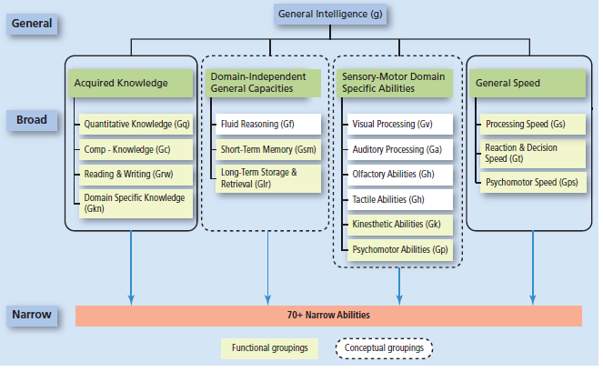
Figure 7.4 Cattel-Horn-Carroll Theory of Intelligence

Slide 29
Theories of Intelligence 6 of 6
Neuroscience theories
Parieto-Frontal Integration Theory: frontal and pariental brain areas play the most important roles with regard to brain area and function
Researchers suggest other areas such as the posterior cingulate cortex, insular cortex, and specific subcortical areas also play critical roles

Slide 30
Measuring Intelligence 1 of 2
Learning Objective 7.7 Compare and contrast some methods of measuring intelligence.
Intelligence quotient (IQ): a number representing a measure of intelligence, resulting from the division of one’s mental age by one’s chronological age and then multiplying that quotient by 100
Stanford-Binet Intelligence Scales yield an IQ score
Allows testers to compare intelligence levels of people from different age groups

Slide 31
Measuring Intelligence 2 of 2
Wechsler Intelligence Tests yield a verbal score and a performance score, as well as an overall score of intelligence

Slide 32
Table 7.3 Simulated Sample Items From the Wechsler Adult Intelligence Scale 1 of 2
Simulated Sample Test Items | Blank cell
Verbal Comprehension Index | Blank cell
Similarities | In what way are a circle and a triangle alike? In what way are a saw and a hammer alike?
Vocabulary | What is a hippopotamus? What does “resemble” mean?
Information | What is steam made of? What is pepper? Who wrote Tom Sawyer?
Perceptual Reasoning Index | Blank cell
Block Design | After looking at a pattern or design, try to arrange small cubes in the same pattern.
Matrix Reasoning | After looking at an incomplete matrix pattern or series, select an option that completes the matrix or series.
Visual Puzzles | Look at a completed puzzle and select three components from a set of options that would re-create the puzzle, all within a specified time limit.

Slide 33
Table 7.3 Simulated Sample Items From the Wechsler Adult Intelligence Scale 2 of 2
Sample Test Items | Blank cell
Working Memory Index | Blank cell
Digit Span | Recall lists of numbers, some lists forward and some lists in reverse order, and recall a mixed list of numbers in correct ascending order.
Arithmetic | Three women divided 18 golf balls equally among themselves. How many golf balls did each person receive? If two buttons cost $0.15, what will be the cost of a dozen buttons?
Processing Speech Index
Symbol Search | Visually scan a group of symbols to identify specific target symbols, within a specified time limit.
Coding | Learn a different symbol for specific numbers and then fill in the blank under the number with the correct symbol. (This test is timed.)
Simulated items and descriptions similar to those in the Wechsler Adult Intelligence Scale—Fourth Edition (2008).

Slide 34
Test Construction: Good Test, Bad Test? 1 of 4
Learning Objective 7.8 Identify ways to evaluate the quality of a test.
Reliability: the tendency of a test to produce the same scores again and again each time it is given to the same people
Validity: the degree to which a test actually measures what it’s supposed to measure

Slide 35
Test Construction: Good Test, Bad Test? 2 of 4
Standardization: the process of giving test to a large group of people that represents kind of people for whom the test is designed
Norms: scores from the standardization group
Most intelligence tests follow a normal curve

Slide 36
Test Construction: Good Test, Bad Test? 3 of 4
Deviation IQ scores: a measure of intelligence that assumes that IQ is normally distributed around a mean of 100 with a standard deviation of about 15
IQ of 130 would be two standard deviations above the mean
IQ of 70 would be two standard deviations below the mean

Slide 37
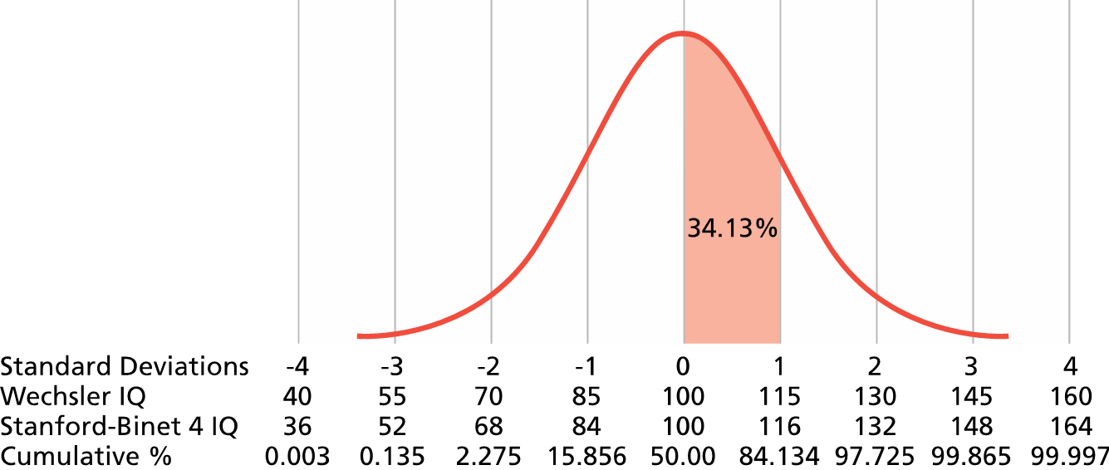
Figure 7.5 The Normal Curve
The percentages under each section of the normal curve represent the percentage of scores falling within that section for each standard deviation (SD) from the mean. Scores on intelligence tests are typically represented by the normal curve. The dotted vertical lines each represent one standard deviation from the mean, which is always set at 100. For example, an IQ of 115 on the Wechsler represents one standard deviation above the mean, and the area under the curve indicates that 34.13 percent of the population falls between 100 and 115 on this test. Note: The figure shows the mean and standard deviation for the Stanford-Binet Fourth Edition (Stanford-Binet 4). The Stanford-Binet Fifth Edition was published in 2003 and now has a mean of 100 and a standard deviation of 15 for composite scores.

Slide 38
Test Construction: Good Test, Bad Test? 4 of 4
Cultural bias
Cultural free tests
Usefulness of IQ tests
IQ tests are generally valid for predicting academic success and job performance
Neuropsychology
Head injury, learning disabilities, neuropsychological disorders

Slide 39
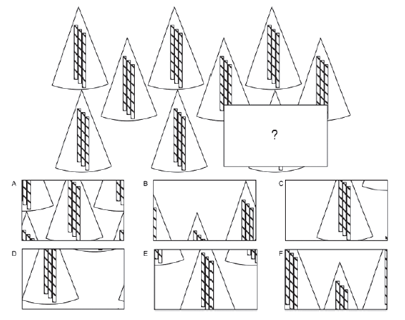
Figure 7.6 Sample Test Items from Ravens Progressive Matrices

Slide 40
Individual Differences in Intelligence 1 of 5
Learning Objective 7.9 Define intellectual disability, giftedness, and emotional intelligence.
Intellectual disability (intellectual developmental disorder): a person exhibits deficits in mental ability and adaptive behavior
IQ falls below 70
Adaptive behavior is severely deficient for a person of a particular chronological age
Formerly known as mental retardation or developmentally delayed

Slide 41
Individual Differences in Intelligence 2 of 5
Intellectual disability can vary from mild to profound
Causes
Deprived environments
Chromosome and genetic disorders
Alcohol
Dietary deficiencies
Toxins in environment

Slide 42
Individual Differences in Intelligence 3 of 5
Gifted: the 2 percent of the population falling on the upper end of the normal curve and typically possessing an IQ of 130 or above
Does giftedness guarantee success?

Slide 43
Individual Differences in Intelligence 4 of 5
Terman conducted a longitudinal study that demonstrated that gifted children grow up to be successful adults, mostly
Terman’s study criticized for a lack of objectivity, because he became too involved in the lives of his “Termites”, even to the point of interfering on their behalf.

Slide 44
Individual Differences in Intelligence 5 of 5
Emotional intelligence: awareness of and ability to manage one’s own emotions, as well as the ability to be self-motivated, to feel what others feel, and to be socially skilled
Viewed as a powerful influence on success in life

Slide 45
The Nature/Nurture Issue Regarding Intelligence
Learning Objective 7.10 Evaluate the influence of heredity and environment on the development of intelligence.
Twin and adoption studies
Stronger correlations found between IQ scores as genetic relatedness increases
Heritability of IQ is estimated at 0.50
Flynn effect: IQ scores steadily increasing over time in modernized countries
The Bell Curve: a book that made widely criticized claims about heritability of intelligence
Stereotype threat

Slide 46
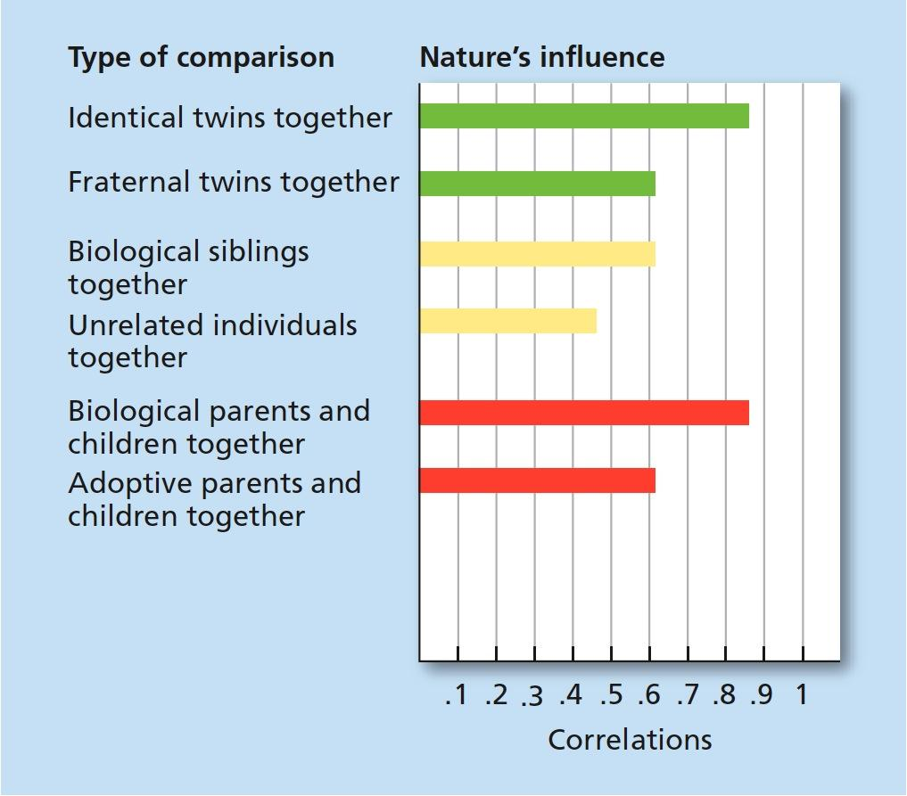
Figure 7.7 Correlations Between IQ Scores of Persons With Various Relationships 1 of 2
In the graph, the degree of genetic relatedness seems to determine the agreement (correlation) between IQ scores of the various comparisons. For example, identical twins, who share 100 percent of their genes, are more similar in IQ than fraternal twins, who share only about 50 percent of their genes, even when raised in the same environment.

Slide 47
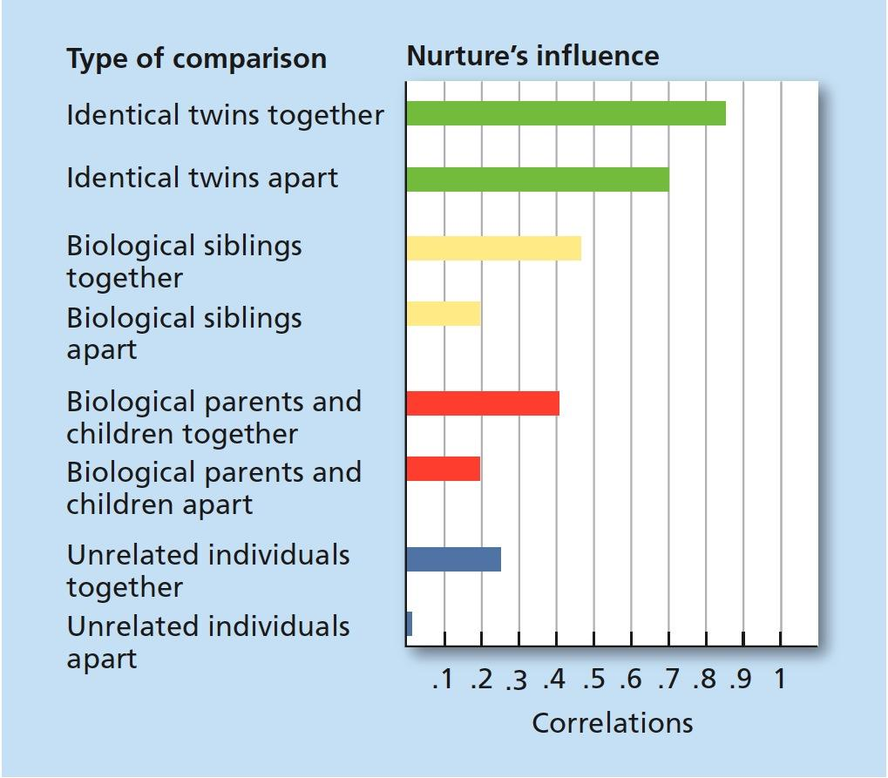
Figure 7.7 Correlations Between IQ Scores of Persons With Various Relationships 2 of 2
In the graph, identical twins are still more similar to each other in IQ than are other types of comparisons, but being raised in the same environment increases the similarity considerably.

Slide 48
The Levels of Language Analysis 1 of 3
Learning Objective 7.11 Identify the different elements and structure of language.
Language: a system for combining symbols (such as words) so that an unlimited number of meaningful statements can be made for the purpose of communicating with others

Slide 49
The Levels of Language Analysis 2 of 3
Grammar: the system of rules governing the structure and use of a language
Phonemes: the basic units of sound in a language
Morphemes: the smallest units of meaning within a language

Slide 50
The Levels of Language Analysis 3 of 3
Syntax: the system of rules for combining words and phrases to form grammatically correct sentences
Semantics: rules for determining the meaning of words and sentences
Pragmatics: aspects of language involving the practical ways of communicating with others, or the social niceties of language

Slide 51
Development of Language
Learning Objective 7.12 Explain how language develops.
Language allows children:
To think in words rather than just images
To ask questions
To communicate their needs to others
To form concepts
Child-directed speech: the way adults and older children talk to infants and very young children, with higher-pitched, repetitious, sing-song speech patterns

Slide 52
Table 7.4 Stages of Language Development
1. Cooing | At around 2 months of age, babies begin to make vowel-like sounds.
2. Babbling | At about 6 months, infants add consonant sounds to the vowels to make a babbling sound, which at times can almost sound like real speech. Deaf children actually decrease their babbling after 6 months while increasing their use of primitive hand signs and gestures (Petitto & Marentette, 1991; Petitto et al., 2001).
3. One-word speech | Somewhere just before or around age 1, most children begin to say actual words. These words are typically nouns and may seem to represent an entire phrase of meaning. They are called holophrases (whole phrases in one word) for that reason. For example, a child might say “Milk!” and mean “I want some milk!” or “I drank my milk!”
4. Telegraphic speech | At around a year and a half, toddlers begin to string words together to form short, simple sentences using nouns, verbs, and adjectives. “Baby eat,” “Mommy go,” and “Doggie go bye-bye” are examples of telegraphic speech. Only the words that carry the meaning of the sentence are used.
5. Whole Sentences | As children move through the preschool years, they learn to use grammatical terms and increase the number of words in their sentences, until by age 6 or so they are nearly as fluent as an adult, although the number of words they know is still limited when compared to adult vocabulary.

Slide 53
The Relationship Between Language and Thought
Learning Objective 7.13 Evaluate whether or not language influences how people think.
Linguistic relativity hypothesis: the theory that thought processes and concepts are controlled by language
Cognitive universalism: theory that concepts are universal and influence the development of language

Slide 54
Animal Studies in Language
Learning Objective 7.14 Summarize the research on the ability of animals to communicate and use language.
Can animals communicate?
Communicate in many ways
Sounds and behaviors
Can animals use language?
Studies demonstrate animals can develop a basic kind of language, including some abstract ideas
Controversy over lack of evidence that animals can learn syntax, which some feel means that animals are not truly learning and using language

Slide 55
Mental and Physical Exercises for Better Cognitive Health
Learning Objective 7.15 Identify some methods for improving your cognitive health.
Physical Activity, specifically aerobic fitness has demonstrated to improve cognitive function
Mental activities that require creativity and the use of memory abilities can help keep the brain fit
Crossword puzzles
Reading books

