Slide 1
Brain and Behavior

Slide 2
Overview of Nervous System
Nervous System - an extensive network of specialized cells that carry information to and from all parts of the body.
Neuroscience – deals with the structure and function of neurons, nerves, and nervous tissue.
Relationship to behavior and learning.

Slide 3
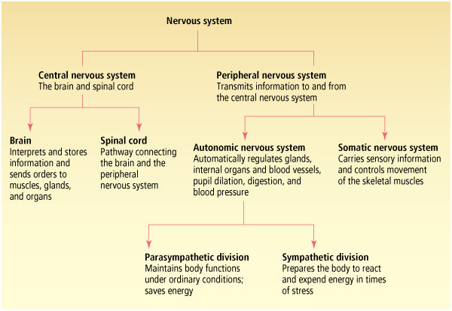

Slide 4
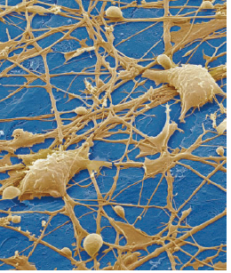
Structure of the Neuron
Neurons - the basic cell that makes up the nervous system and which receives and sends messages within that system.

Slide 5
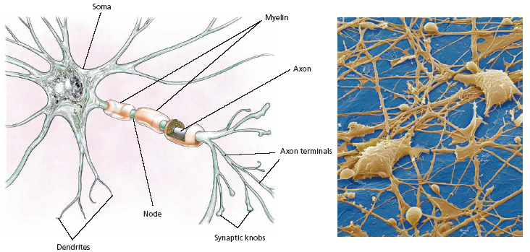
Parts of a Neuron
Dendrites - branch-like structures that receive messages from other neurons.
Soma - the cell body of the neuron, responsible for maintaining the life of the cell.
Axon - long tube-like structure that carries the neural message to other cells.

Slide 6
Other Types of Brain Cells
Glial cells - grey fatty cells that:
provide support for the neurons to grow on and around,
deliver nutrients to neurons,
produce myelin to coat axons,
Myelin - fatty substances produced by certain glial cells that coat the axons of neurons to insulate, protect, and speed up the neural impulse.
clean up waste products and dead neurons.

Slide 7
Neurons in the Body
Nerves – bundles of axons in the body that travel together through the body.
Neurilemma – Schwann’s membrane.
Aids in process of repairing damaged nerve fibers.

Slide 8
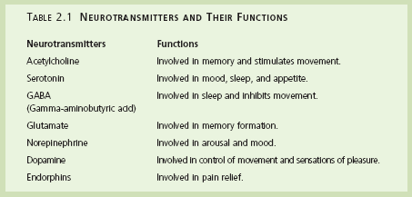
Neurotransmitters

Slide 9
Central Nervous System
Central nervous system (CNS) - part of the nervous system consisting of the brain and spinal cord.
Spinal cord - a long bundle of neurons that carries messages to and from the body to the brain that is responsible for very fast, lifesaving reflexes.

Slide 10
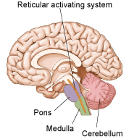
Hind Brain

Slide 11
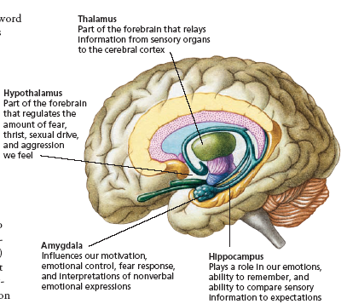

Slide 12
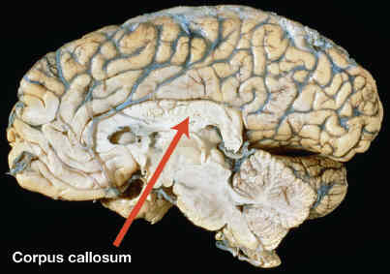
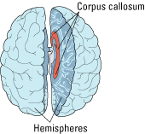
Cerebrum
Cerebral hemispheres - the two sections of the cortex on the left and right sides of the brain.
Cerebral Cortex – Handles processing of sensory information, thinking, learning, conscious movement
Corpus callosum - thick band of neurons that connects the right and left cerebral hemispheres.

Slide 13
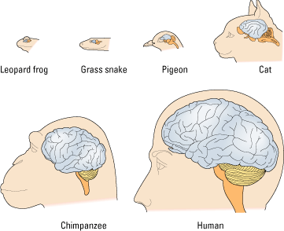
Human cortex compared to various animal species

Slide 14
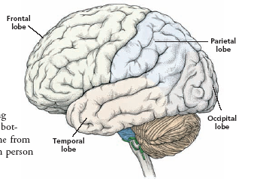
Frontal Lobe

Slide 15
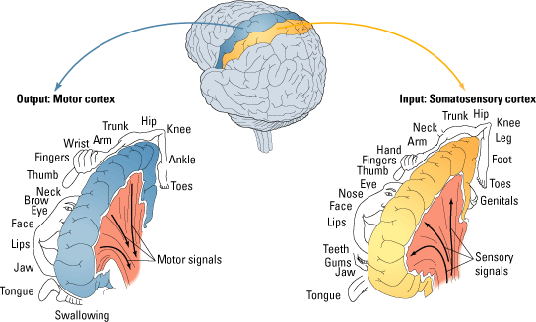

Slide 16
Broca’s Area

Slide 17
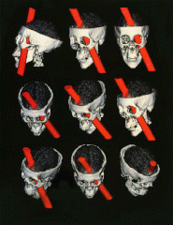
Frontal Association Area

Slide 18
Parietal Lobe

Slide 20
Temporal Lobe

Slide 21
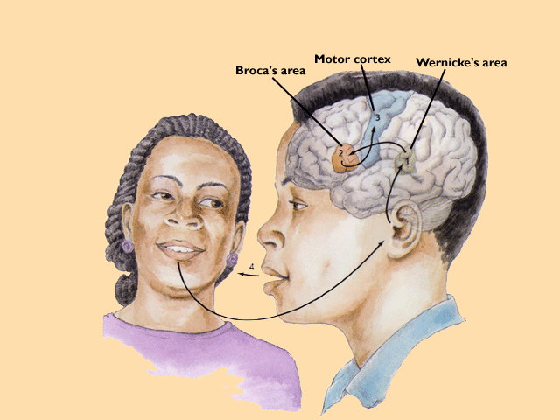
Wernickes and Brocas areas in human speech

Slide 22
Occipital Lobe

Slide 23
Brain specializations
Right and left brain dominance

Slide 24
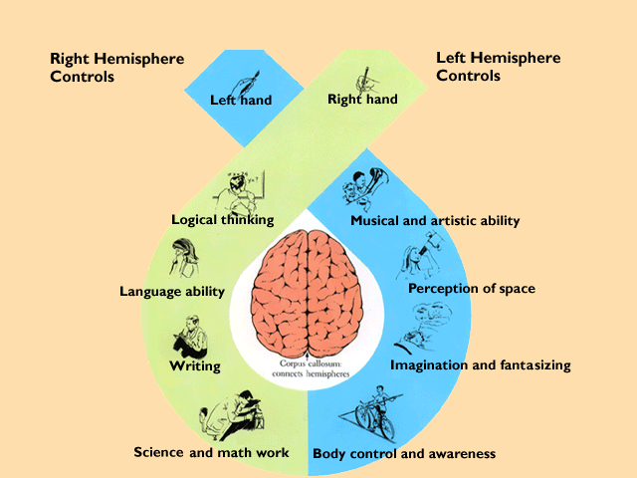
Lateralization of Brain Functioning

Slide 25
Specialized cerebral hemisphere functions in terms of styles of learning and thinking
Right
Recognizing/remembering faces
Visual/kinesthetic instructions
Interprets body language easily
Produces humorous ideas/thoughts
Processes information subjectively
Processes information in patterns
Likes to improvise
Uses metaphors and analogies
Responsive to emotional appeals
Intuitive in problem solving
Uses demonstrations in instructing
Uses images in remembering
Reads for main ideas
Likes fantasy, poetry, etc
Learns best through exploration
Likes open ended assignments
Left
Recognizing/remembering names
Liking verbal instructions
Dependent upon words for meaning
Produces logical ideas/thoughts
Processes information objectively
Processes information sequentially
Likes to have a definite plan
Little use of metaphors and analogies
Responsive to logical appeals
Logical in problem solving
Gives verbal instructions/information
Uses language in remembering
Reads for details and facts
Likes realistic stories
Learns best from systematic plans
Likes well structured assignments

Slide 26
Autonomic Nervous System
Autonomic Nervous System
Nerves that control the automatic (involuntary) muscles, organs, and glands
Part of the peripheral nervous system
Sympathetic division
Allows the organism to deal with stressful events
Anger or fear = fight or flight
Parasympathetic division
Returns the body to a state of normal functioning
Keeps the body in a state of normal functioning during non-stress times.

Slide 27
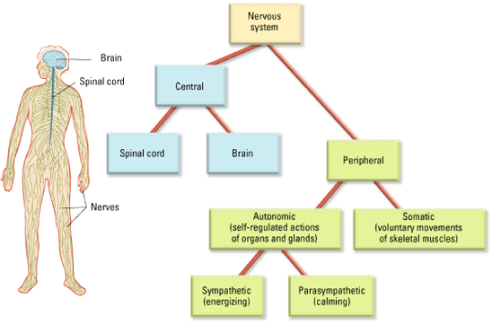

Slide 28
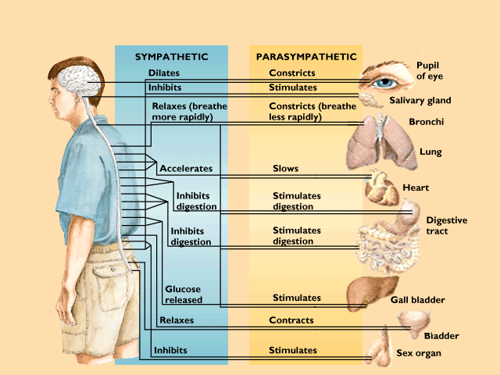
Functions of the Parasympathetic and the Sympathetic Divisions

