Slide 1
Allegory
English 2E

Slide 2
What is an allegory?
a layered story, poem, or picture which can be interpreted on a literal level as well as a metaphorical level. The allegorical interpretation typically reveals a moral, social, or political message.
a story in which the characters and events are symbols that stand for ideas about human life or for a political or historical situation.
a literary device in which characters or events in a literary, visual, dramatic, or musical art form represent or symbolize ideas and concepts.

Slide 3
For Example, George Orwell’s Animal Farm

Slide 4
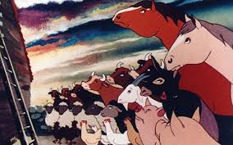
Animal Farm, literally…
Don’t look for any hidden meanings or symbols.
What happens in the story?
Who are the characters?
The story is about crazy, power- hungry pigs who take over a farm and oppress their fellow animals.

Slide 5
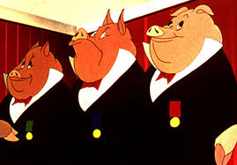
Animal Farm, Allegorically…
Look for hidden meanings and symbols.
What could the events of the story represent?
Who do the characters symbolize?
George Orwell expects you to see the pigs as the communist leaders of Soviet Russia.
The Farm is meant to be the USSR.
Other animals on the farm represent different people or groups of people from Soviet Russia.

Slide 6
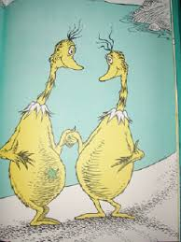
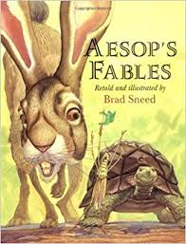
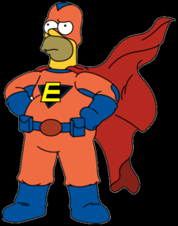
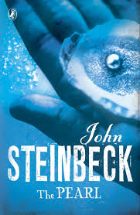
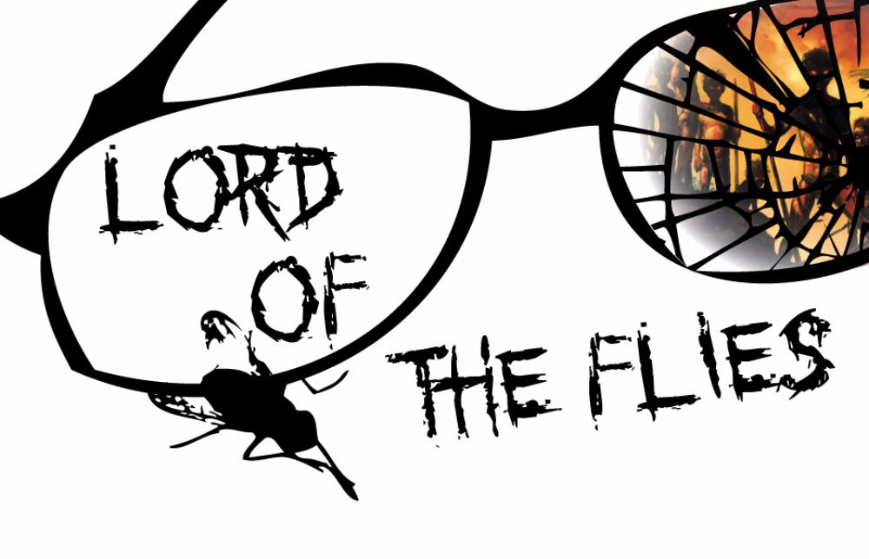
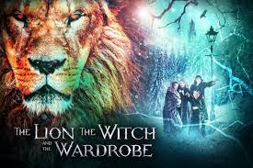
While allegories use metaphor, symbolism, personification, and other literary devices to deliver their message, these devices are not by themselves an allegory.
When a whole story (long or short) is meant to be read as a representation of some human idea, concept, or historical event, it is an allegory and should be read beyond the literal meanings.

Slide 7
What an Allegory is not: Maus, by Art Spiegelman

Slide 8
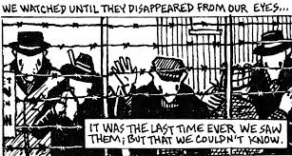
Check for allegorical qualities
Well, it…
uses animals to tell the story,
communicates hidden meanings about different racial groups to tell a Holocaust survival story,
brilliantly uses symbolism and metaphor over the course of the entire story.

Slide 9
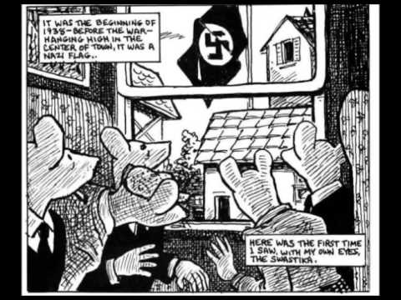
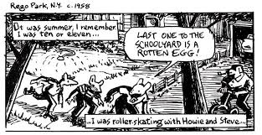
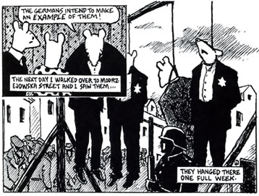
But, the story is
about real events, real places, and real characters,
literally a biography of a Holocaust survivor and his son.
NOT an allegory

Slide 10
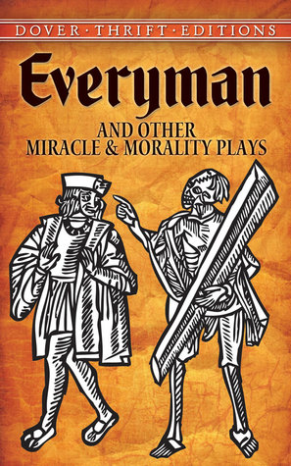
More examples of allegory
Everyman, Anonymous
15th-century morality play that uses allegorical characters to examine the question of Christian salvation and what Man must do to attain it.

Slide 11
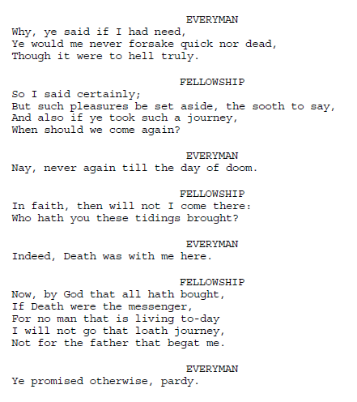

Slide 12
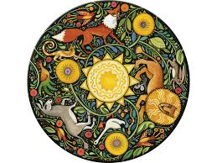
Aesop’s Fables
A fable is a kind of allegory.
Aesop’s Fables were some of the first examples of allegory.
Aesop was a Greek story teller who lived around 620 – 564 BCE (200 years before Plato and pals!).
The stories attributed to him often use animals to tell allegorical stories.

Slide 13
“The Grasshopper and the Ants”

Slide 14
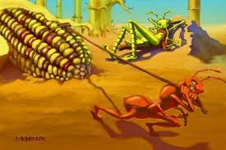
Literal Analysis
What happens in the story?
Who are the characters?
Literary devices?
Read the story here.

Slide 15
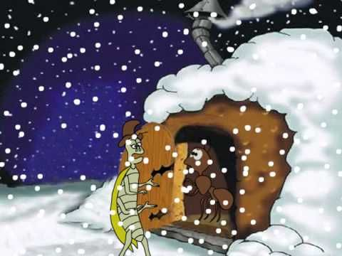
Allegorical analysis
What could the events in the story represent?
What/who do the characters represent?
What is the moral, social, or political message?

Slide 16
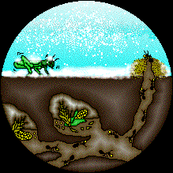
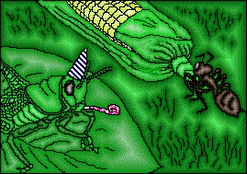
Your turn
With a partner, choose a picture book.
Read the story aloud as a group.
Conduct the analysis (handout) together.
When complete, staple your work together and turn it in!

