Slide 1
SAT Overview with animal pictures
Kara Lycke

Slide 2
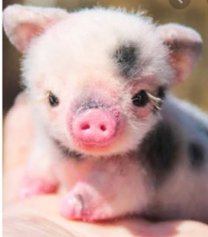
https://collegereadiness.collegeboard.org/pdf/official-sat-study-guide-introduction.pdf

Slide 4
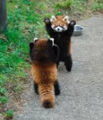
The Reading Test
All Reading Test questions are multiple choice and
based on passages.
Some passages are paired with other passages.
Informational graphics, such as tables, graphs, and charts, accompany some passages—but no math is required.
Prior topic-specific knowledge is never tested.

Slide 5
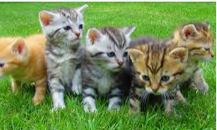
The Reading Test always includes…
One passage from a classic or contemporary work of U.S. or world literature.
One passage or a pair of passages from either a U.S. founding document or a text in the Great Global Conversation they inspired. The U.S. Constitution or a speech by Nelson Mandela, for example.
A selection about economics, psychology, sociology, or some other social science.
Two science passages (or one passage and one passage pair) that
examine foundational concepts and developments in Earth
science, biology, chemistry, or physics.

Slide 6
What the Reading Test Measures

Slide 7
Command of Evidence
Find evidence in a passage (or pair of passages) that best supports the answer to a previous question or serves as the basis for a reasonable conclusion.
Identify how authors use evidence to support their claims.
Find a relationship between an informational graphic and the passage it’s paired with.

Slide 8
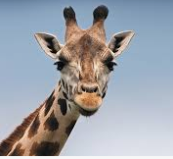
Words in Context
Many questions focus on important, widely used words and phrases that you’ll find in texts in many different subjects.
Use context clues in a passage to figure out which meaning of a word or phrase is being used.
Decide how an author’s word choice shapes meaning, style, and tone.

Slide 9
Analysis in History, Social Science, and Science
Questions ask you to draw on the reading skills needed most in those subjects. For instance, you might read about an experiment then see questions that ask you to:
Examine hypotheses.
Interpret data.
Consider implications.
Answers are based only on the content stated in or implied by the passage.

Slide 10
Writing and Language Test

Slide 11
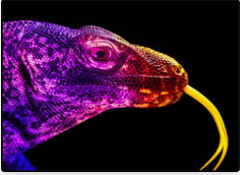
Read.
Find mistakes and weaknesses.
Fix them.

Slide 13
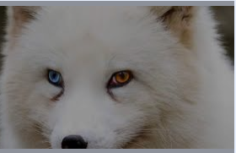
What the Writing and Language Test Is Like
You’ll need to:
look closely at a single sentence
read the entire piece and interpret a graphic
For instance, you might be asked to choose a sentence that corrects a misinterpretation of a scientific chart or that better explains the importance of the data.
The passages you improve will range from arguments to nonfiction narratives and will be about careers, history, social studies, the humanities, and science.

Slide 14
What the Writing and Language Test Measures

Slide 15
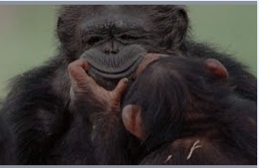
Like before…
Command of Evidence
Words in Context
and…

Slide 16
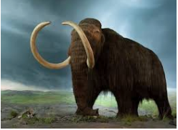
Analysis in History, Social Studies, and Science
Read passages with a critical eye and make editorial decisions that improve them.

Slide 17
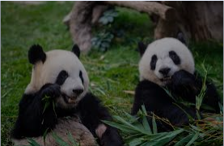
Expression of Ideas
Questions about a passage’s organization and its impact.
For instance, you will be asked which words or structural changes improve how well it makes its point and how well its sentences and paragraphs work together.

Slide 18
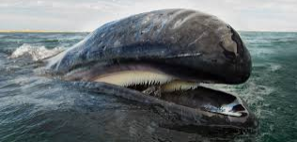
English Conventions
Sentence structure
Usage
Punctuation
Change verb tense, parallel construction, subject-verb agreement, and comma use.
Or make NO CHANGE.

